Slide 1

CINF 308 Final Project: Exploring Django By: Jacob Foppes

Slide 2

Django
Django is an open source full stack web development platform that can be used to create websites using python and HTML
Django combines HTMLS, CSS, JavaScript and a powerful Python backend to enable developers to create dynamic and responsive web content.

Slide 3

Why use Django?
Django provides a framework for web development to helps to get the basics of a web development project out of the way so that you can focus on creating your application/site.
Not only is Django highly scalable, it includes almost all of the components you may need for a web project, such as login capabilities, database connectivity, and application security

Slide 4
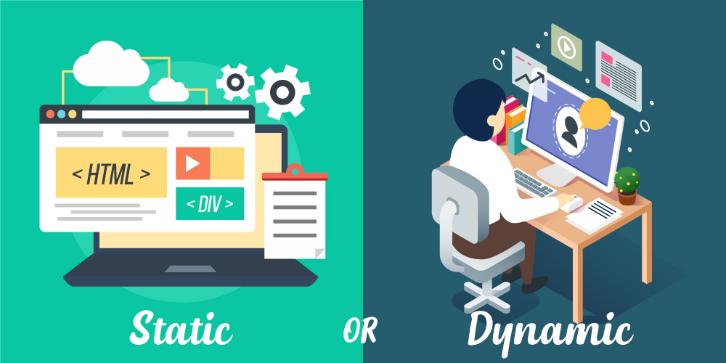
Dynamic VS Static
Web pages In this context can be broken down into 2 different categories. Dynamic and Static
Static Pages display the same content to anyone who views the page. The splash page for company website that introduces the company what they do would be an example
Dynamic Pages display different info based on the user who is viewing them. For example, a banking website displays the authenticated users bank account info.

Slide 5
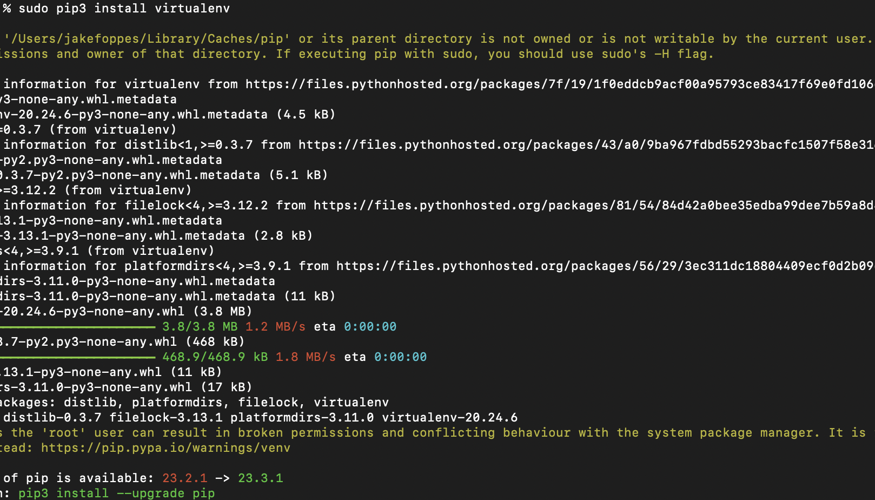
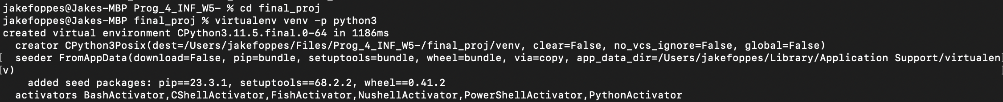
Getting Started
Django is best operated in a virtual environment so the first step is to install a virtual environment on your computer
Once you have installed your preferred virtual environment package, create a new virtual environment in which you will operate Django

Slide 6
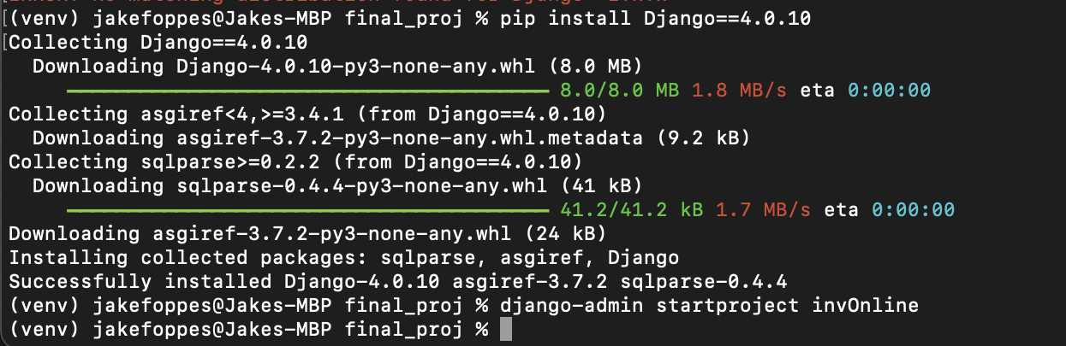
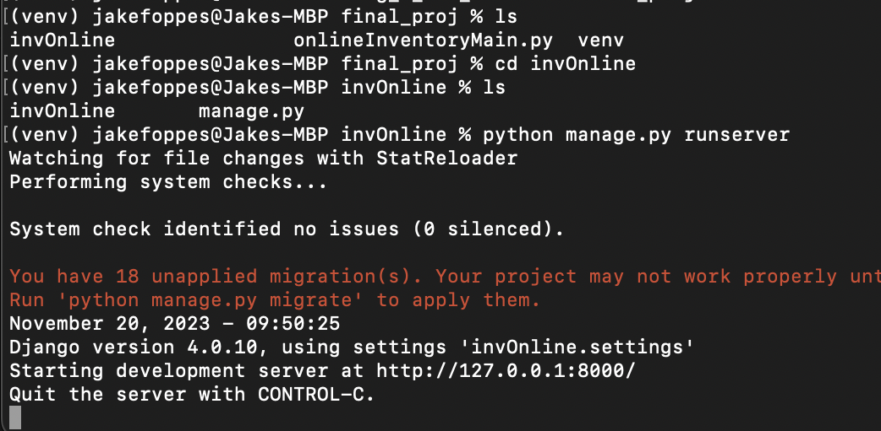
Getting Started
Once your virtual environment is set up, install Django
When Django finishes installing, you create a new webserver from the folder you choose in your virtual environment
In this example, our environment is called “venv” and our Django project is called “invOnline”
At this point you have created your Django web projected and can now start to create your webpage

Slide 7
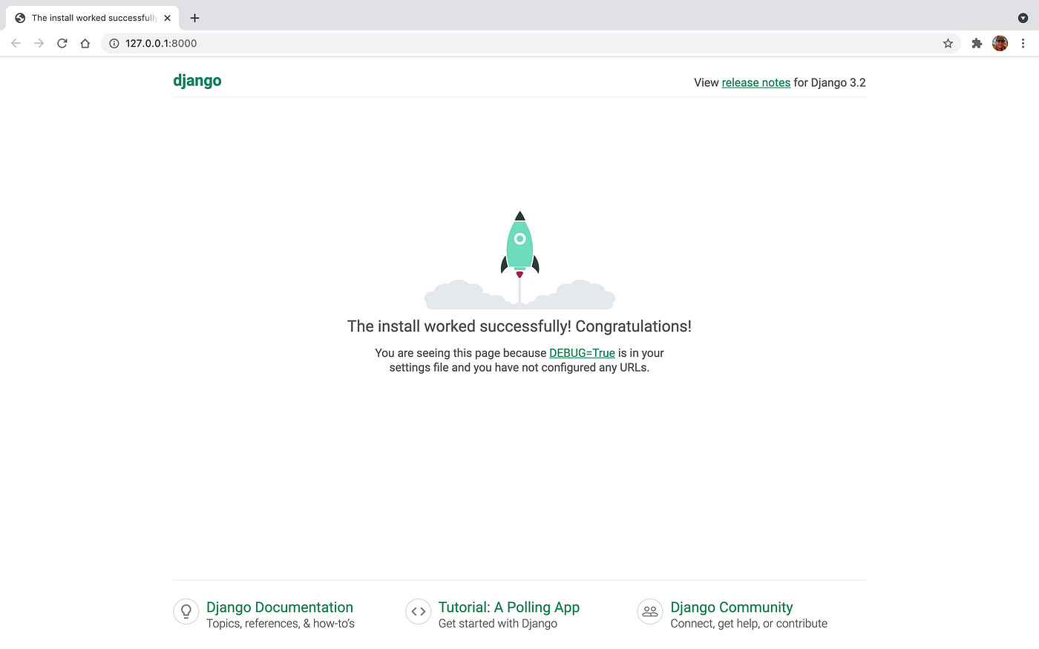
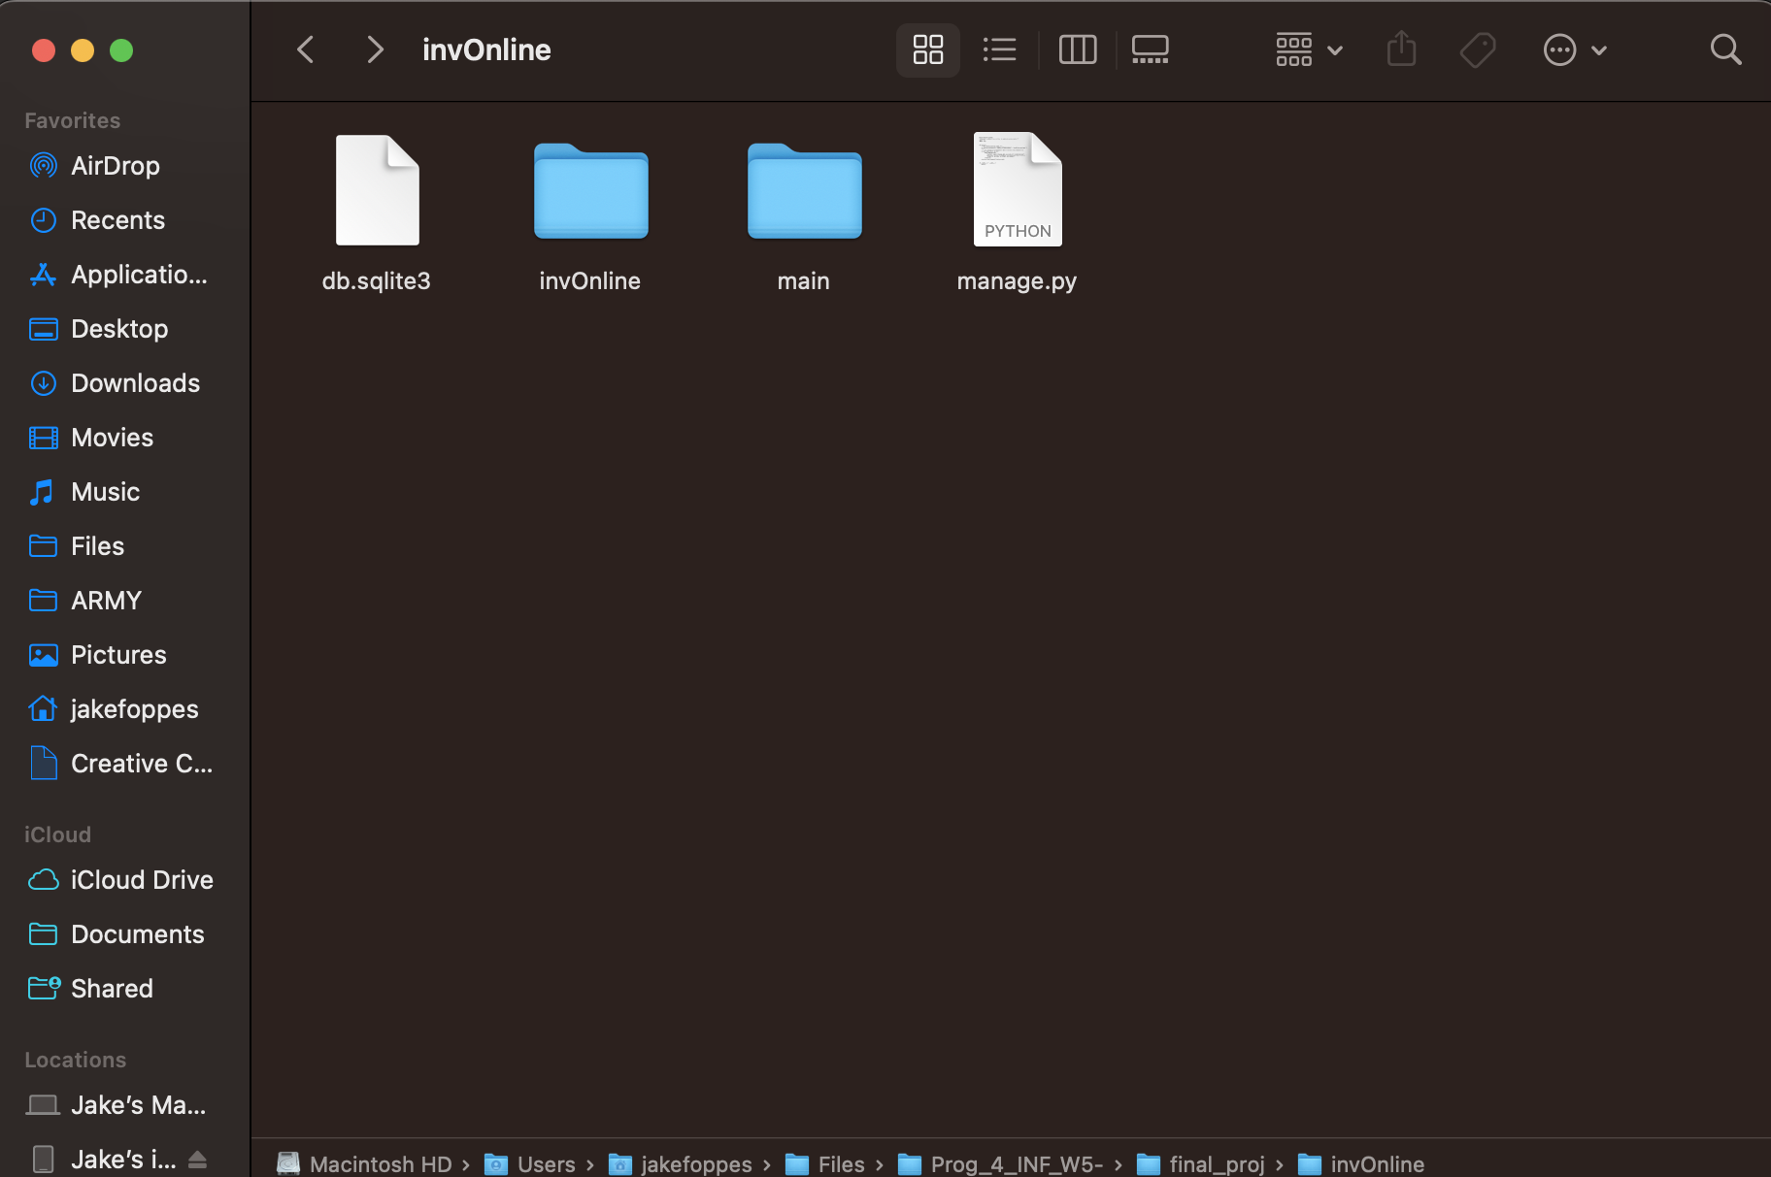
Getting Started
Inside your new site folder you should now see a newly generated folders and files for your site, and you can access you site at the address provided in the terminal when you launched the site

Slide 8
Default Features of Django Web Apps
When you create a Django web app, you are greeted with default files that will help you configure your webpage
settings.py
Is where you will define applications and pages for your site
manage.py
Runs your Djago web app
Database
Django has support for various database platform that you can integrate into your site
urls.py
This is where you will define the different URLS to different pages or “views” for your site

Slide 9
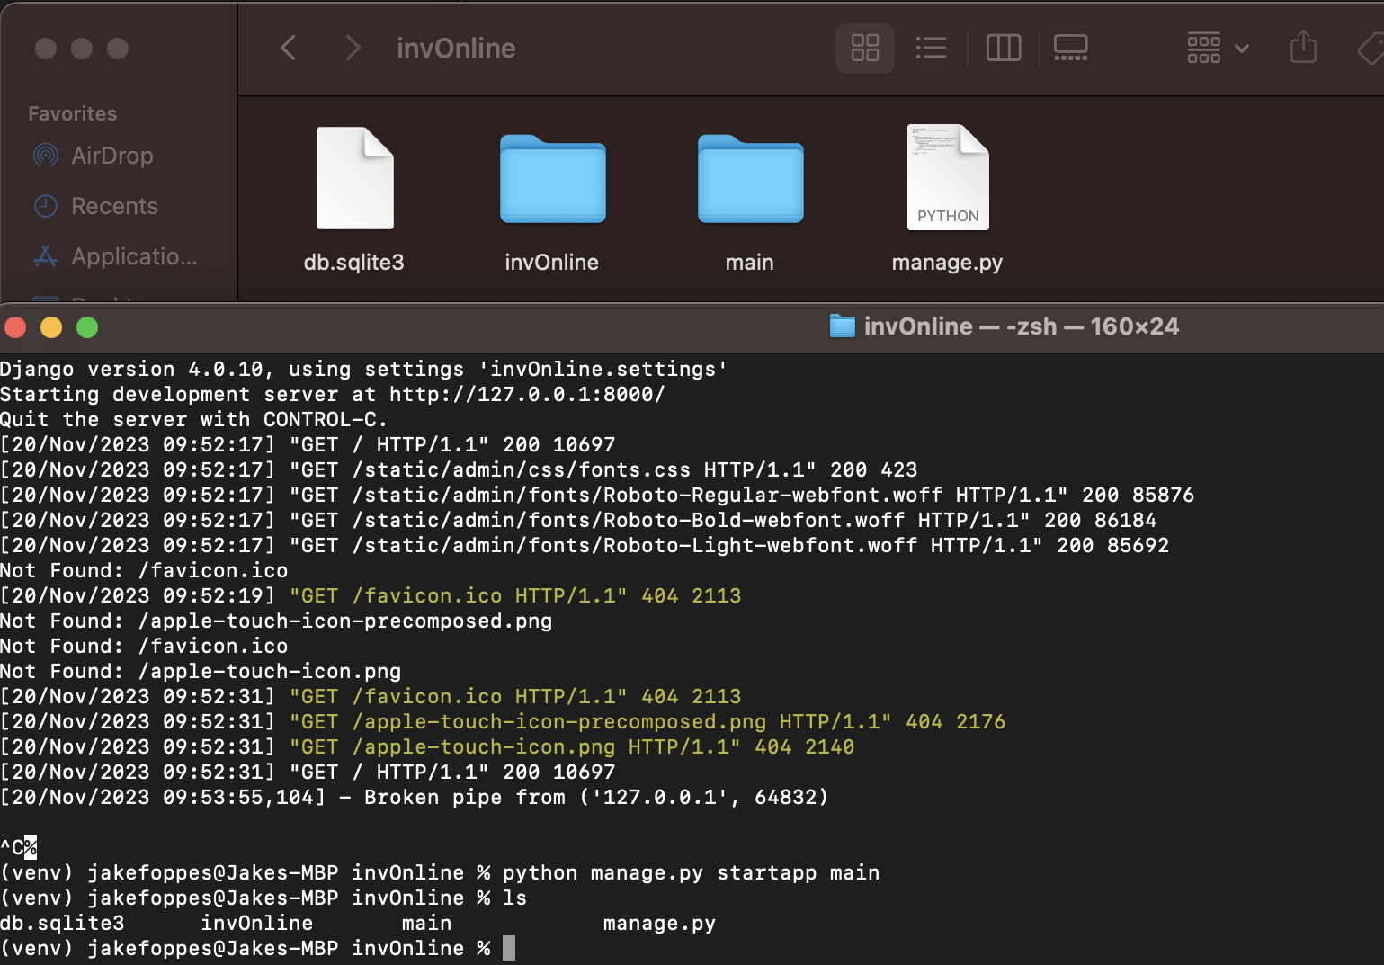
What’s in an App
In the example to the right, I have created my project called “invOnline”, and a new app called ”main”
“main” has its own settings and url files, and a models file to define data models for use within the app

Slide 10
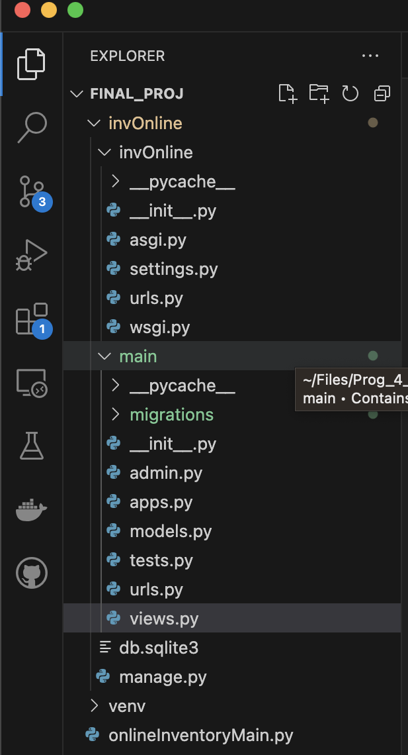
What’s in an App
“main” also contains a views.py file where you will different functions to display different pages.

Slide 11
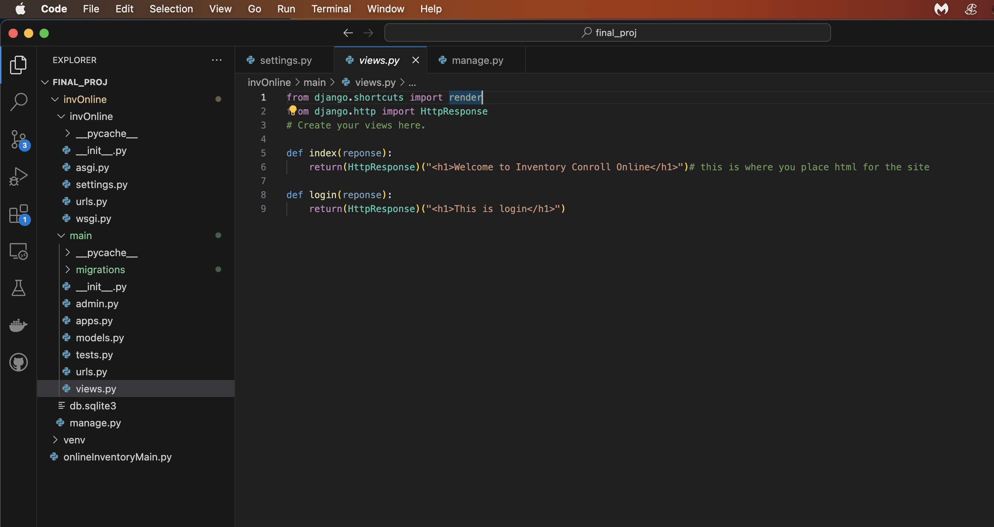
What’s in an App
In my example I have two functions, one that displays a page with a welcome message, and one that displays a header for a login page

Slide 12
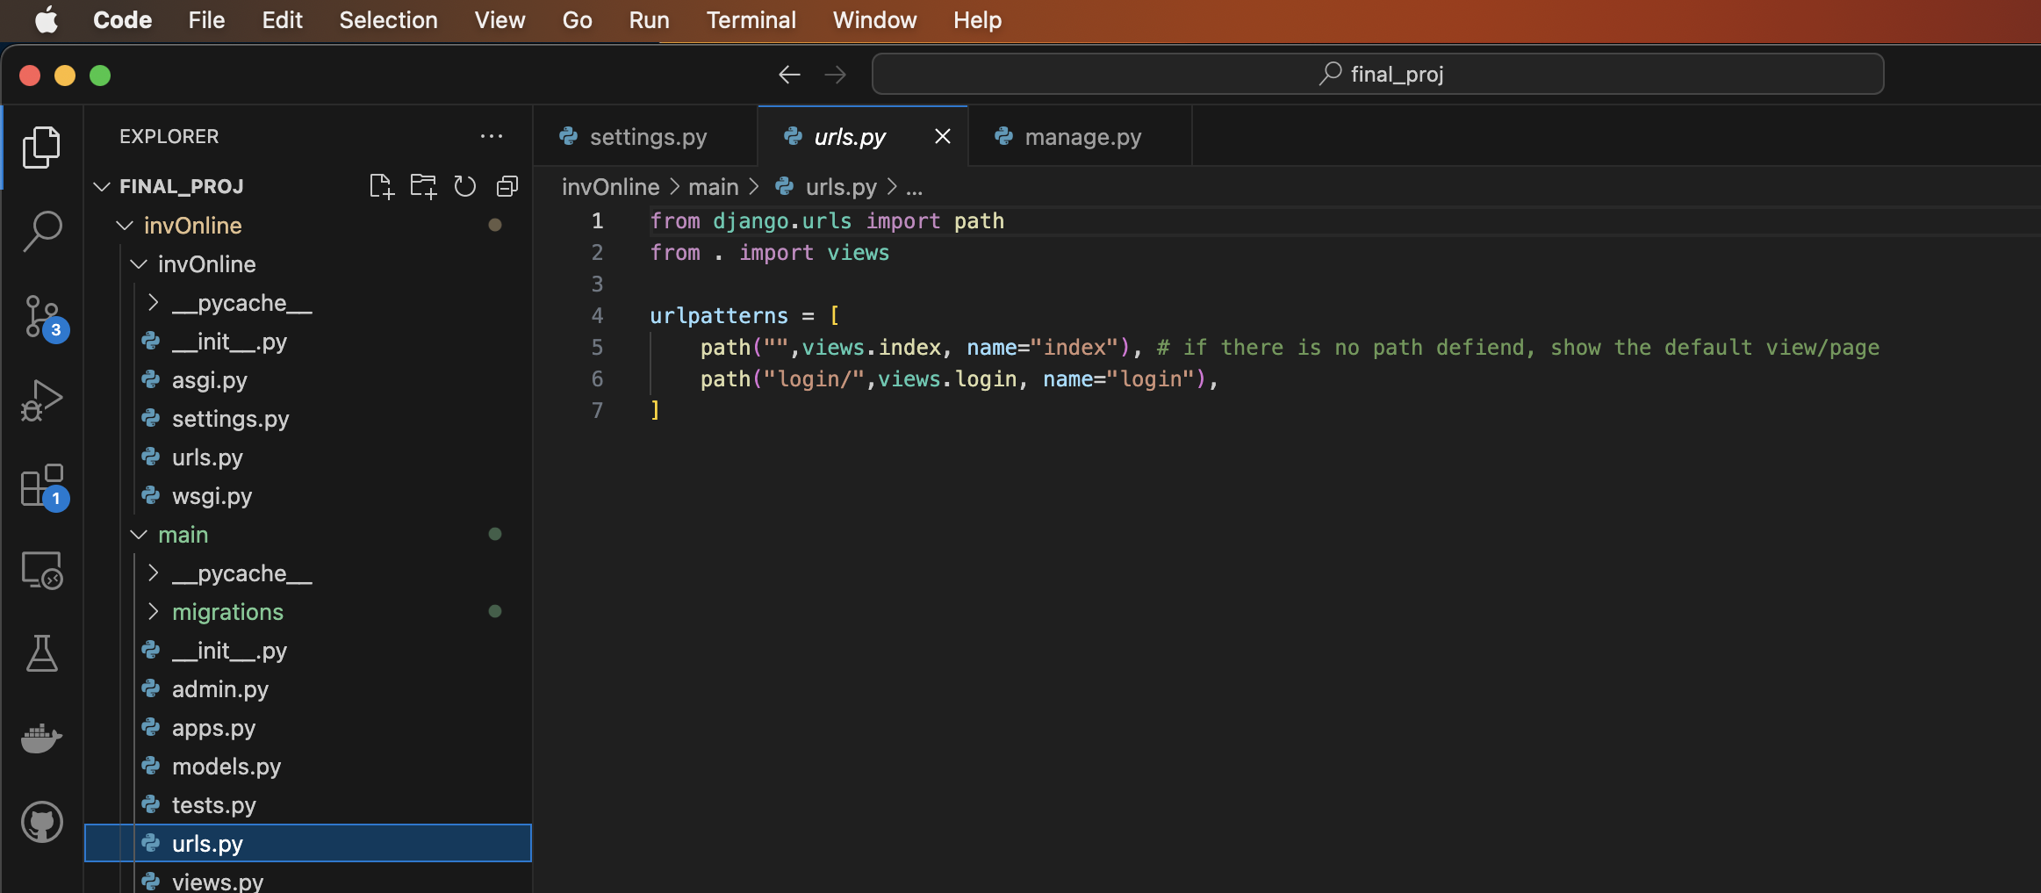
What’s in an App
Once you create views, they have to added to to urls.py files so that they can be accessed thought the site

Slide 13

Conclusion
Django is a powerfull web development platform that can be used to create interactive, dynamic and secure web applications without all the overhead of building a web application from scratch.
I look forward to continuing to learn more about it as I continue my studies at UA

Slide 14
Citations
MozDevNet. (n.d.). Django Introduction - Learn Web Development: MDN. MDN Web Docs. https://developer.mozilla.org/en-US/docs/Learn/Server-side/Django/Introduction
Tim, T. W. (2019). YouTube. YouTube. Retrieved December 2, 2023, from https://www.youtube.com/@TechWithTim
Telusko (2019). YouTube. YouTube. Retrieved December 2, 2023, from
https://www.youtube.com/@Telusko

